Slide 1

Personal Reading Procedures
Reading for High School and Beyond
By; Holden Stengel

Slide 2

Critical Thinking
the objective analysis of an issue in order to form a judgment of things your reading about. Make sure you try your hardest to think of subjects your learning you could think of something really cool. Be excited!!! Because you could learn something great.

Slide 3

Pre-reading
Start by reading the first lines of each section and if there are section titles read them also. And if your Naturalistic you will picture yourself outside
Look over charts and pictures. Visual learner will visualize different way of see this
Take a moment and take in what you just read.
Think of ways you can relate to what you just read. If your naturalist like me it will be easy be you picture yourself outside in nature.
I make sure to think how can this reading relate to me.
Be excited about what your about to read!!!!!!

Slide 4


Reading
Never take note while reading the section wait tell your done with the section so you get the most important things.
After your don’t reading take notes or highlight important things.
Then if you have any questions write them in the margins.
Then review all the questions that you wrote and try to asker them without looking in your book or your notes.
I make sure to have read all of it before reading it because I like to visualize it before I write it down.

Slide 5
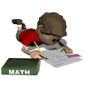
Review after Reading
Get a new sheet of paper and write a summary of what you read in your own words.
I like to read through my notes again and look at pictures because one of my strong points is visualize it so I don’t forget anything.
If you do most of those step you will be ready for class.

Slide 6

Basic Things to Remember
That if your teacher gave you an assignment its more than likely its important.
If a reading doesn’t make sense then read it out loud.
Times the number of pages by 5 so you have plenty of time to visualize and understand the data

Slide 7
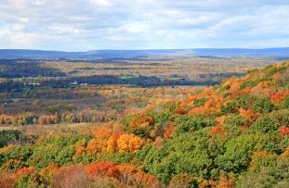
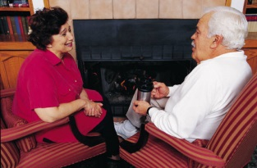

Learning Styles
Naturalistic
Bodily Kinesthetic
Musical
Interpersonal
Intrapersonal
Visual Spatial
Logical Mathematical
Verbal Linguistic

Slide 8
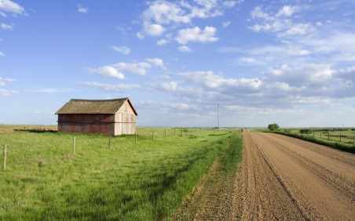
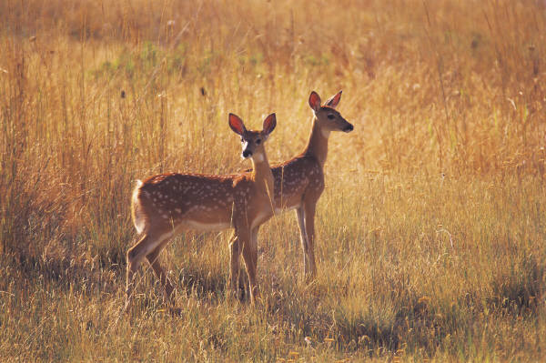
Naturalistic Learner
Often understands patterns of living things and apply scientific reasoning to the world. You can tell the difference between certain plants and animals. Normal careers for people with thing kind of learning are farmer, naturalist, animal behavior, and scientist.
Tips for learning
Observe data and record data and when writing summary make it in real world situations

Slide 9
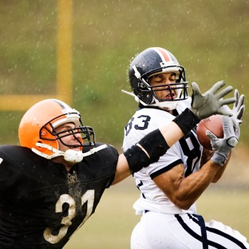

Bodily-Kinesthetic Learner
You think in movements
Like you want to achieve goals
Like surgeons athletes and directors
The best way to bring in information is to do an activity just like sports.
Tips to help you are; make games out of things, stay active when studying or doing homework.

Slide 10
Musical Learner
You probably sing to yourself
Can tell when something is off key.
Tips to help;
List to songs when you studying and reply it before a test
Create a rhyme to study with
Connect a song you like to what your learning

Slide 11

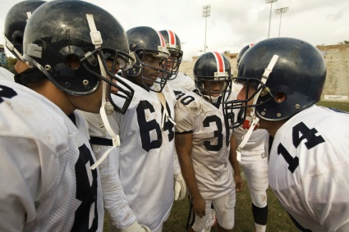
Interpersonal Learner
You understand what people say or why act a certain way
You take leadership roles when necessary and enjoy sharing thoughts
Tips to help;
Talks out problems
Receives and gives feedback
Active learner in tutoring or mentoring

Slide 12

Intrapersonal Learner
You learn by yourself
You set goals and self-manage yourself
They do good in jobs like a writer, pilot, and teacher
Tips for help;
Study alone in quiet environment
Set goals and monitor your progress
Reflect what you have already learned

Slide 13

Visual-Spatial Leaner
You learn best when you see things
Good jobs for people with this kind of learning painters and designers
Tips for help;
Use projects to show what you learned.
Draw pictures next to your notes
Organize things in color
Visualize your topic before doing anything.

Slide 14

Logical-Mathematical Learner
You understand complex things or problems
Your good at finding solutions and asking questions
Tips for Help;
Think about it in a puzzle
Find your own hypotheses
Create an outline for your organizing so you can read it step by step.

Slide 15

Verbal-Linguistic Learner
You hear a word and you know exactly what it is.
Your good a reading, writing, listening, and speaking
Tips to Help Study;
Ask questions
Tell stories
Explain complicated subjects in words

Slide 16


Reader Roles
Connector
Questioner
Illustrator
Literary Luminary/Passage Master

Slide 17

Connector
Is when you connect to what your reading and connect to your school or your past. Like if someone's problem you can connect to there problem from your past or to what you read. Like this picture he remembered that he did what they said in the book.

Slide 18


Questioner
Is when you write down a few questions from your reading. Like if you wonder why something happened then you can remember to go back and read more about it. Like the reader in wondering why there are people on the question mark.

Slide 19


Illustrator
Is when you can picture and feel what is happening in your reading. Like if your reading about a battle then you could think of a lot of people dieing for there country. Like this girls is picturing what she is reading in her book.

Slide 20

Literary Luminary/Passage Master
Is when your able to find the important text or quotes. Like if an author say something really important you find it and underline, highlight, or circle.

Slide 21

The End

