Slide 1
Personal reading procedure

Slide 2
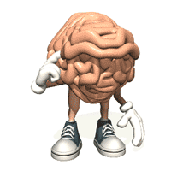
Critical thinking
To be a critical thinker you must use wasted time.
Deal with your ego and fix it.
Redefine the way you see things.

Slide 3
Different reading strategies
Preview
Ask Questions
Illustrating
Take Notes
Make Summary

Slide 4
Before reading
Before you get started reading you might want to preview the section you are about to read and ask questions about it. These are very important because this is where all your reading gets started and you want to get started off right!

Slide 5
Previewing
It might help to preview what you are reading before you get started. For some people who like to be organized it helps to start with 10 page chunks. You can look at the charts, photos, or questions already written in the book if there are any.
It might also help to just simply think about the main topic. If you are an interpersonal learner you could think of what you already know about it and also questions you might have about it.

Slide 6
Ask questions
Asking questions about what you’re reading is a very helpful thing to do. If I am reading and come across something I don’t know what it is I will ask myself a question about it and find the answer for it. These questions could be about what you think you are going to be reading about or something on a picture you saw. If you are a verbal learner it may help to ask these questions out loud.

Slide 7
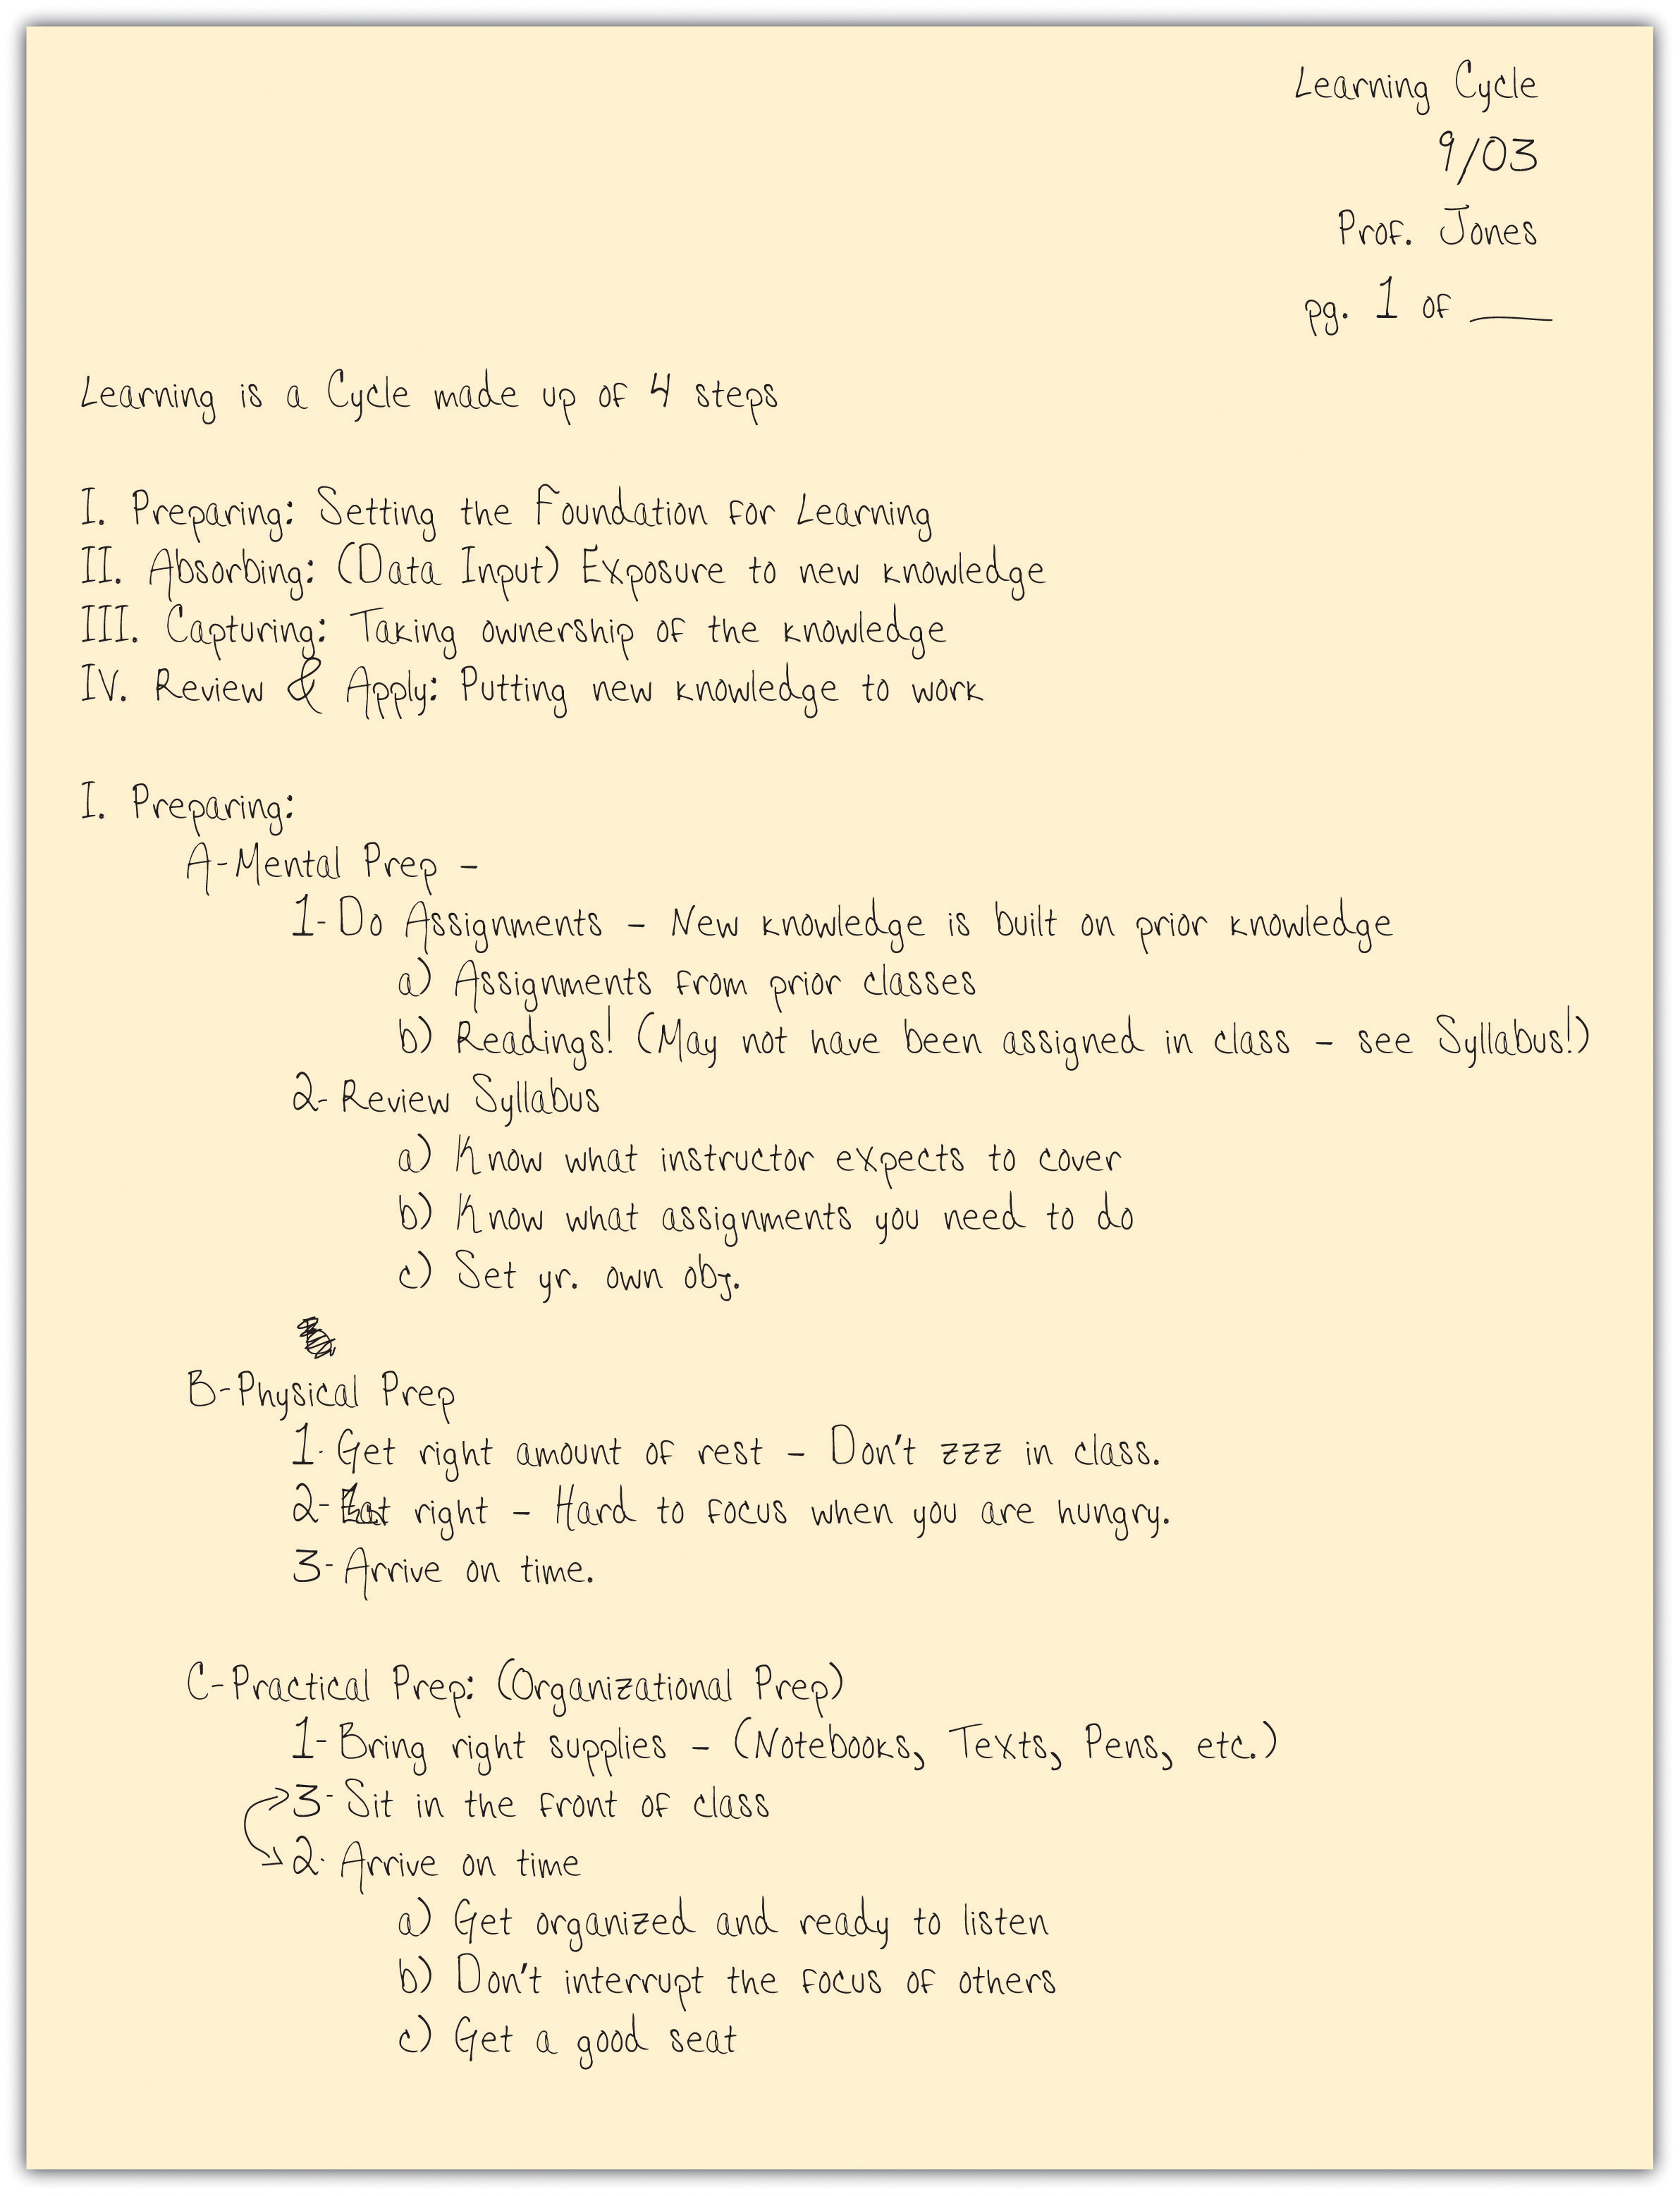
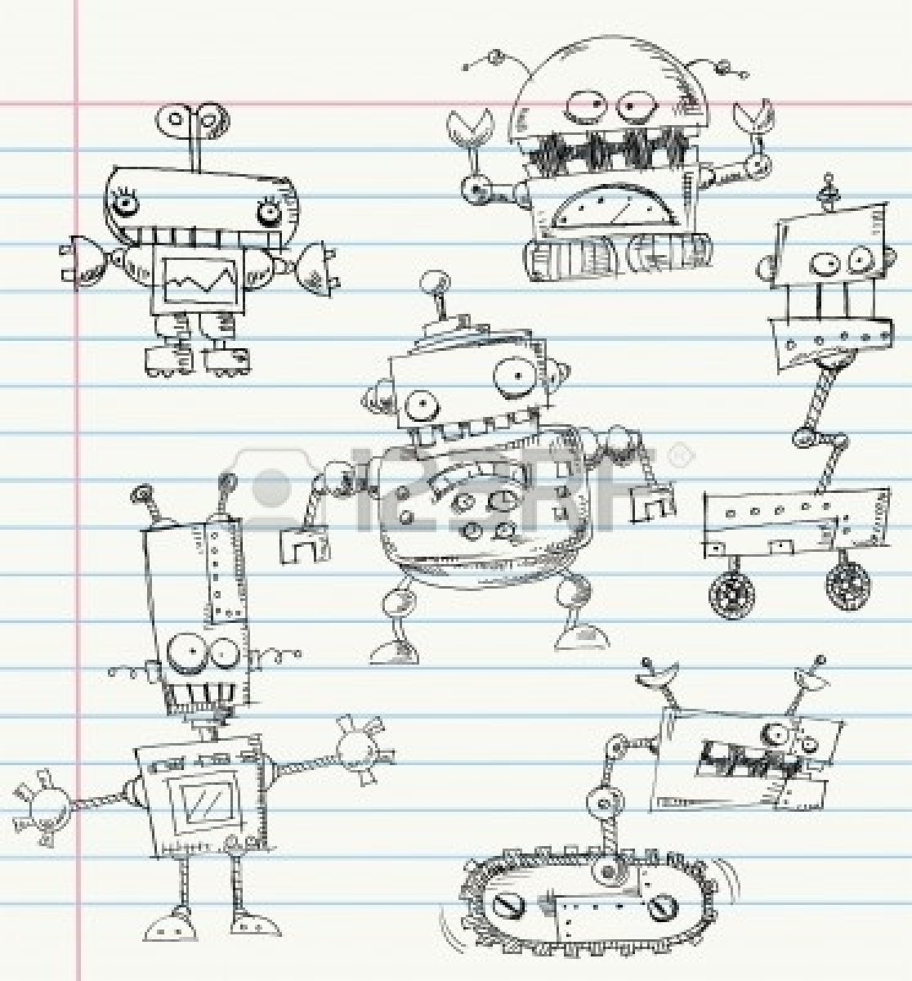
During reading
While you are reading you can ask more question of what you are reading, draw some pictures to help you understand the topic, and take notes. Doing things that help you during reading is very important because you want to make sure you understand.

Slide 8
Questions
Asking questions while you are reading may slow you down but it can help you to understand what you are reading. This time when you are asking questions it may be about what a word meant, what a character did, what you think is going to happen next, why the author used a certain style, or even if you have to… what the whole thing you just read meant. Again, it might help to say them out loud if you are a verbal learner.

Slide 9
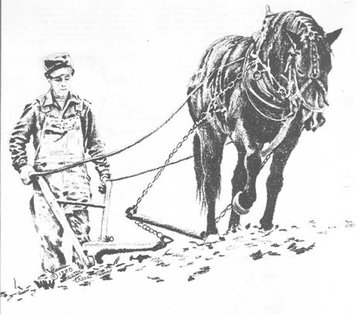
Illustrating
Good readers make pictures in their minds as they read but if you are a visual learner it may be even better to put those pictures on paper. You could even label little important things in that picture if it helps. These pictures don’t have to be any kind of masterpiece (unless you want to), they just need to be some kind of visual aid to help you remember what you were thinking at that time.

Slide 10
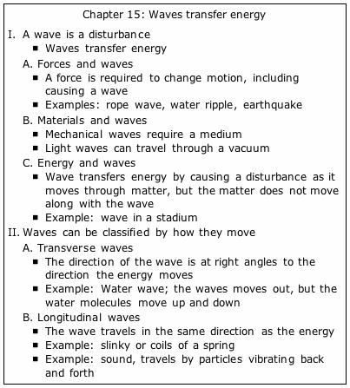
Take notes
I think that taking notes is a VERY important thing to do while you are reading. It’s probably because taking notes is one of the things I do the most to help me remember what I read. Taking notes is something that would probably help you if you are a logical/mathematical learner. I find using an outline is a very effective way to do this and it is good to keep them in your own words. It isn’t necessarily a very good thing to read and write at exactly the same time so it may be smart to finish a paragraph and take notes about it if needed. I also find that if you have a lot of information on your notes you could just highlight the very important parts.

Slide 11
After reading
When you are done reading the section you previewed and read actively, you can still help yourself more by making a summary. It is very essential to review all that you have read because you don’t want all of the time you’ve just spent working to go to waste.

Slide 12
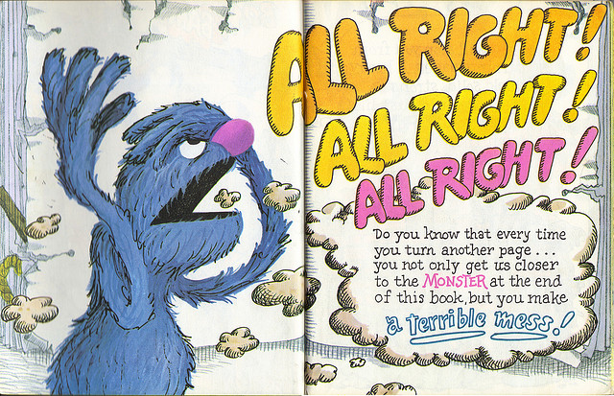
Summary
Making a summary of all that you have just read is a very important part of reading actively. First of all, right after you finish reading you might want to just think about the section. This is also a good time to go back and answer the question you wrote.
You then can write a few good short sentences that you think help you sum up the whole section you read. You want to make sure it makes sense to you and you have to make sure to keep it organized. Making a summary is another good thing for intrapersonal learners to do.

Slide 13
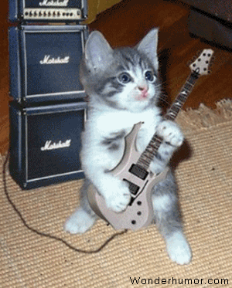
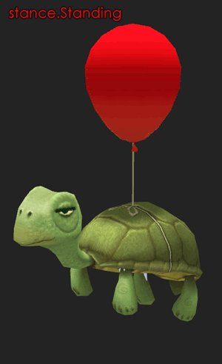
The end

